Slide 1

Commerce Bank System
Final Presentation

Slide 2
Team Members
● Michelle Frost
● Debbie Kirchner
● Brian Roden
● Linden Stirk
● Issac Zeilinger

Slide 3
Stack
● Programming Languages – C#, React
● Backend – .NET API
● Database – Microsoft SQL Server
● Frontend – React, Sass
● Web Hosting – Google Cloud
● User Authentication – Firebase

Slide 4
Prototype Design

Slide 5
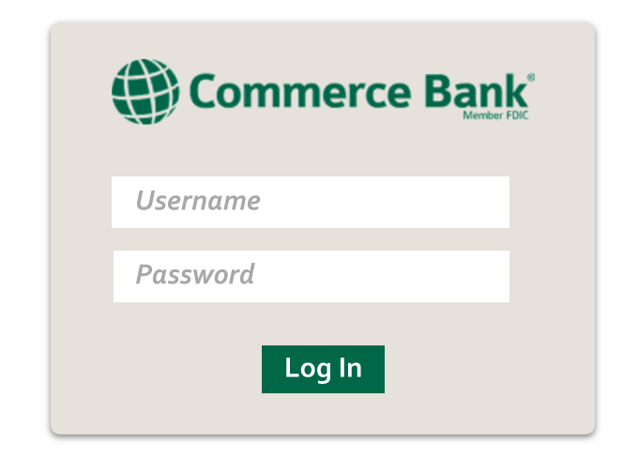

Slide 6
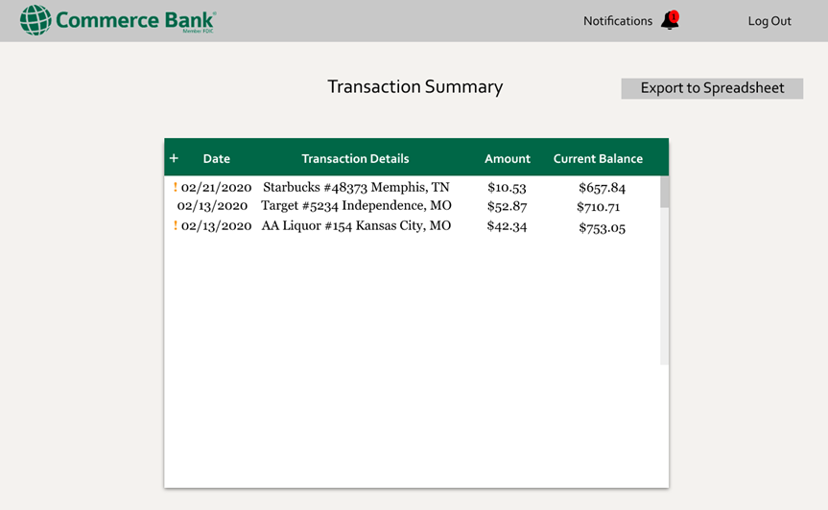

Slide 7
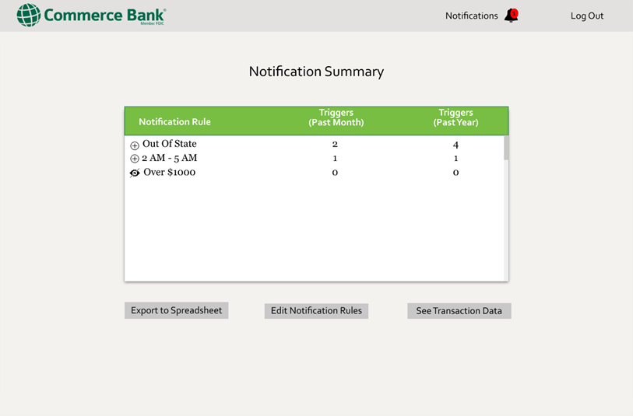

Slide 8
UI Design

Slide 9
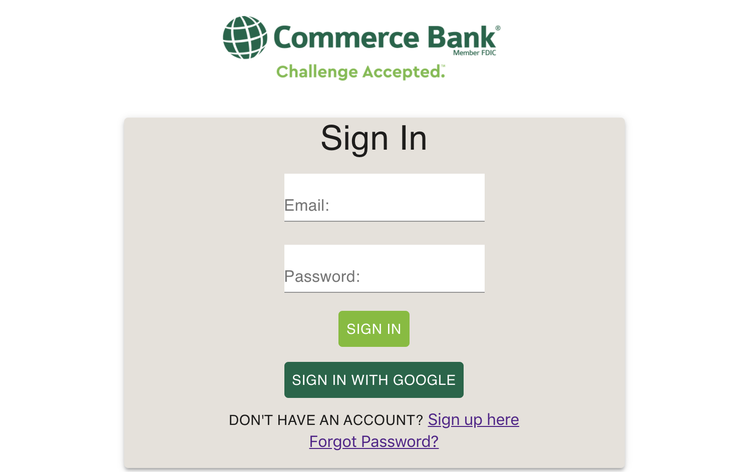

Slide 10
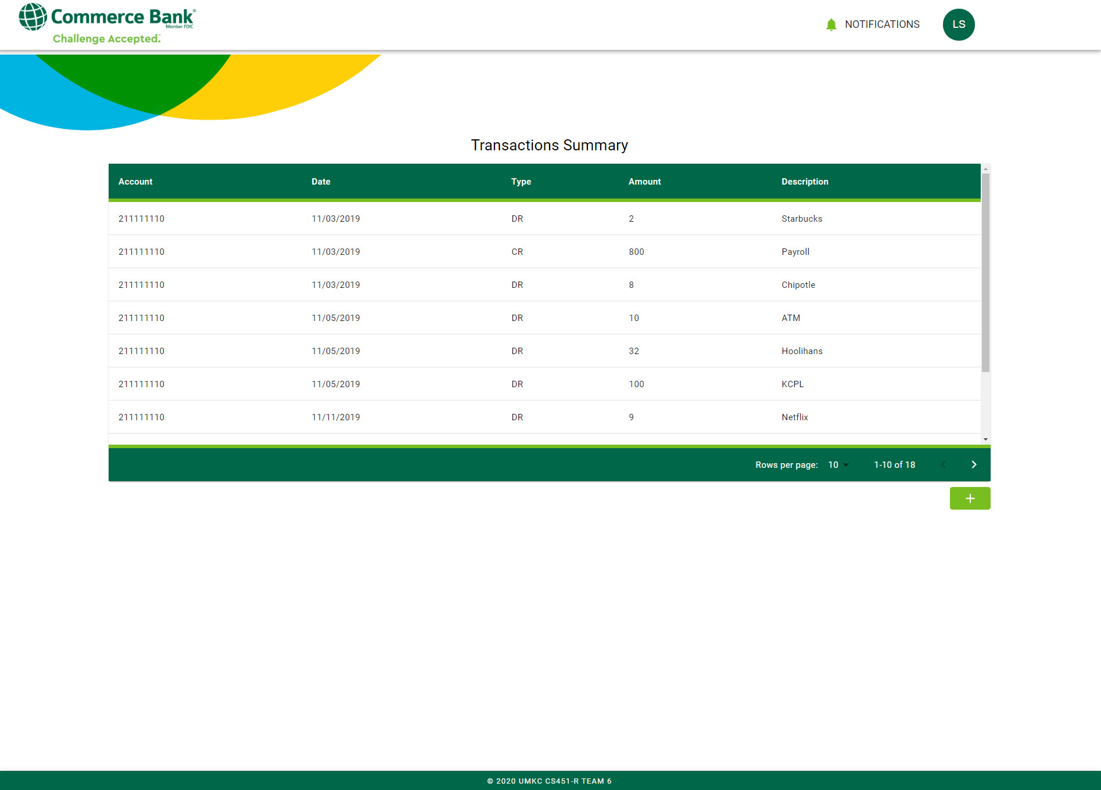

Slide 11
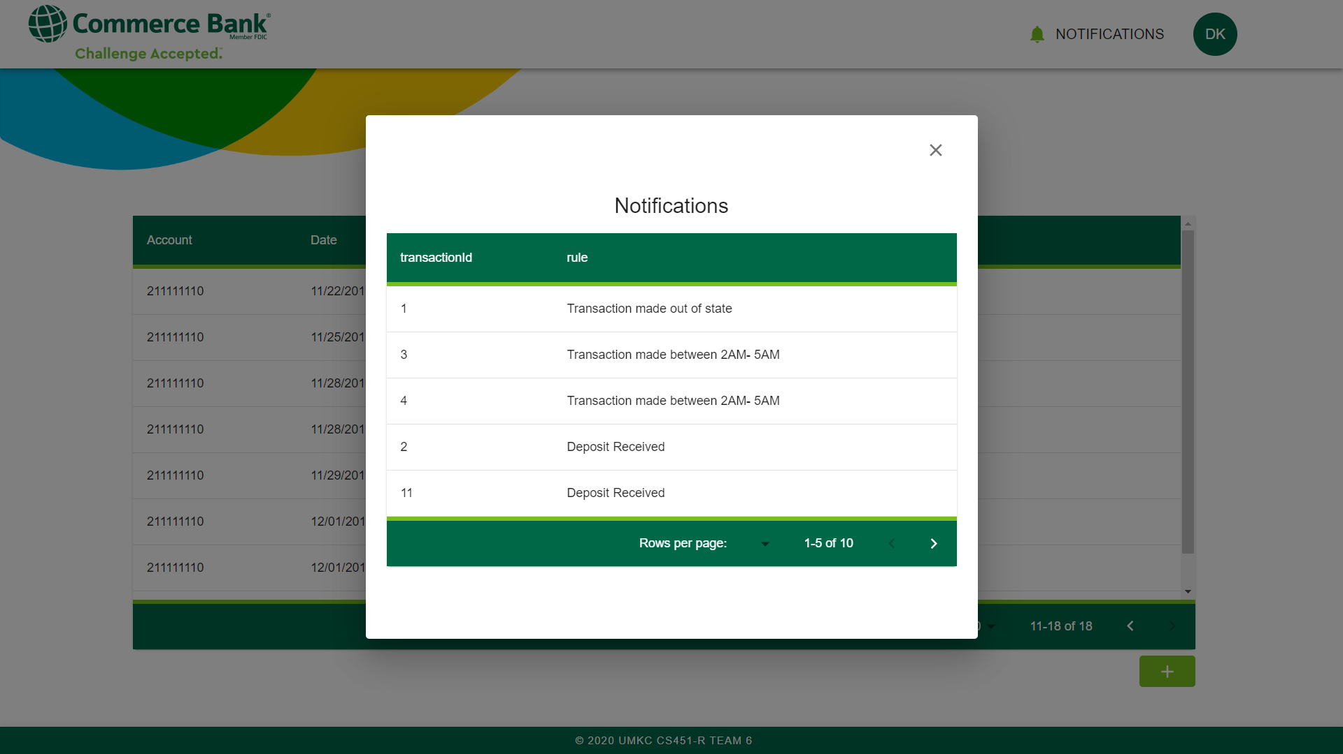

Slide 12
Thanks!

